Slide 1



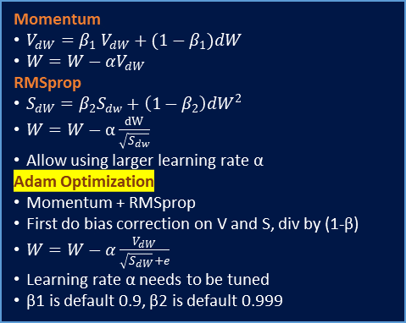
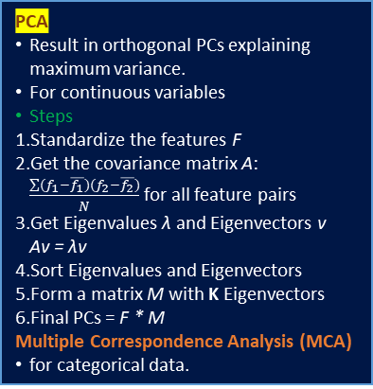
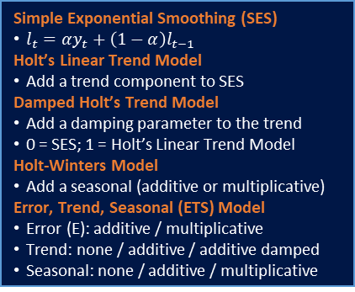
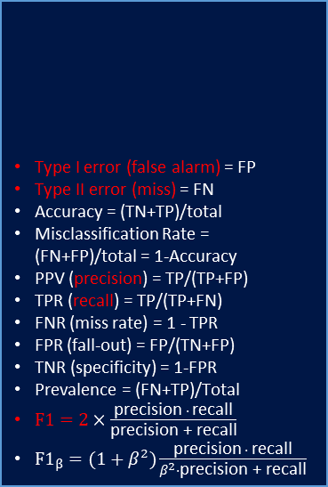
4 Assumptions of Linear Regression
Linear in parameters
Independent X
No perfect multicollinearity
X not correlated to residuals
Residuals
0 mean
equal variance
no autocorrelation
normality
Normal X and Y if maximum likelihood
Central Limit Theorem
Sample means are normally distributed
Shapley Value
Distribution of payoff under fair conditions
no waste: all payoff distributed
Equal contributed players receive equal payoff
Zero contribution players receive zero payoff
The game cannot be divided further
Avg expected marginal contribution of a player from all possible combinations.
Autocorrelation Function (ACF)
Correlation of a series with a delayed copy of itself, as a function of delay
Ljung-Box Test
Exam if a time-series is white noise
Small p-value => not white noise
Mean Absolute Scaled Error (MASE)
Independent of data scale
Can handle y close to 0
Equal penalty to pos/neg/large/small errors
MASE=1 is equivalent to one-step naive
Type I error (false alarm) = FP
Type II error (miss) = FN
Accuracy = (TN+TP)/total
Misclassification Rate = (FN+FP)/total = 1-Accuracy
PPV (precision) = TP/(TP+FP)
TPR (recall) = TP/(TP+FN)
FNR (miss rate) = 1 - TPR
FPR (fall-out) = FP/(TN+FP)
TNR (specificity) = 1-FPR
Prevalence = (FN+TP)/Total
$F1=2×\frac{\text{precision} ∙ \text{recall}}{\text{precision} \text{+} \text{recall}}$
$F1_{β}=(1+β^{2})\frac{\text{precision} ∙ \text{recall}}{β^{2}∙\text{precision}\text{ + }\text{recall}}$
 |  | predictions
 |  | 0 | 1
actual | 0 | TN | FP
 | 1 | FN | TP
PCA
Result in orthogonal PCs explaining maximum variance.
For continuous variables
Steps
Standardize the features F
Get the covariance matrix A: $\frac{\sum{(f_{1}−\overline{f_{1}})(f_{2}−\overline{f_{2}})}}{N}$ for all feature pairs
Get Eigenvalues λ and Eigenvectors v Av = λv
Sort Eigenvalues and Eigenvectors
Form a matrix M with K Eigenvectors
Final PCs = F * M
Multiple Correspondence Analysis (MCA)
for categorical data.
Bagging (Bootstrap Aggregating)
Bootstrap
Repeatedly sample with replacement
Form many models with the same bias
On average will take around 2/3 of data
Averaging to reduce variance
Random Forest
Also sample m predictors before each split
Biased toward frequent classes
Boosting
Iteratively build weak classifiers
At each iteration, assign more weight to observations with larger error
Sensitive to outliers
Shapiro-Wilk Test
Exam Normal Distribution
Null: normal
t-test
Exam equal (large/small) mean(s)
Assumption: sample from normal with equal variances
Null: equal (large/small)
F-test
Exam equal (large/small) variance(s)
Assumption: sample from normal
Null: equal (large/small)
Chi-Square Test
Independence between Two Categorical Variables
Null: independent
Simple Exponential Smoothing (SES)
$l_{t}=αy_{t}+\left(1−α\right)l_{t−1}$
Holt’s Linear Trend Model
Add a trend component to SES
Damped Holt’s Trend Model
Add a damping parameter to the trend
0 = SES; 1 = Holt’s Linear Trend Model
Holt-Winters Model
Add a seasonal (additive or multiplicative)
Error, Trend, Seasonal (ETS) Model
Error (E): additive / multiplicative
Trend: none / additive / additive damped
Seasonal: none / additive / multiplicative
Entropy
Level of information/uncertainty
Entropy of a discrete random variable X with n possible outcomes:
Relative Entropy (KL Divergence)
How one probability distribution (PD) is different from a reference PD.
For discrete probability P and Q defined on the same probability space X, the relative entropy from Q to P:
Stationary
Constant mean, variance, autocorrelation over time.
Box-Cox Transformation
Variance Stabilization
Useful for ts with increasing variation
Useful to ARIMA (but not ETS)
Differencing (non-seasonal / seasonal)
Mean Stabilization
Momentum
$V_{dW}=β_{1} V_{dW}+(1−β_{1})dW$
$W=W−αV_{dW}$
RMSprop
$S_{dW}=β_{2}S_{dw}+\left(1−β_{2}\right)dW^{2}$
$W=W−α\frac{dW}{\sqrt{S_{dw}}}$
Allow using larger learning rate α
Adam Optimization
Momentum + RMSprop
First do bias correction on V and S, div by (1-β)
$W=W−α\frac{V_{dW}}{\sqrt{S_{dW}}+e}$
Learning rate α needs to be tuned
β1 is default 0.9, β2 is default 0.999
K-means Clustering
To minimize within-cluster-variation
Standardized continuous variables
Generalization (Gaussian Mixture)
No need standardized features
k-modes, k-prototypes
Non continuous variables
Optimal number of K
Silhouette coefficient
Steps
Randomly select centroids.
Assign all points to closest centroids.
Recompute centroids of newly formed clusters.
Repeat 2 and 3.
ARIMA
Regression based forecasting
Autoregressive (AR): p lagged observations
Moving Average (MA): q lagged errors
d number of differencing
Seasonal ARIMA(p,d,q)(P,D,Q)m
(P,D,Q): seasonal differences and lags
m: number of observations per period
Dynamic Regression (ARIMA X)
Combine external predictors with ARIMA
Model error term as ARIMA process
Dynamic Harmonic Regression
Non-seasonal ARIMA + Fourier terms
Assume fixed seasonal patterns
VARMA
Vector ARMA: generalized to multivariate time-series.
MLE
Parameter (point) estimation
Formulate log-likelihood based on assumed distribution
Optimize with gradient descent, quasi-newton etc

